Slide 1
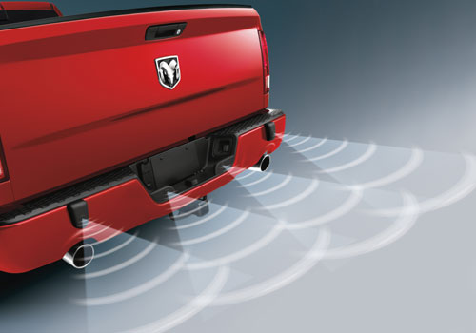
Car Backup Sensor:
By: Curran, Corey, and RoB

Slide 2
Why we chose this project?
Professor Rodriguez demonstration during the first week of class intrigued us
Also, We chose to do this project because we found it to be very interesting, especially since it applies to something that many people use every day

Slide 3
Abstract:
The result that we hope to achieve, is a sensor which will display, on an LED screen, the distance that it is from an object. We will add warning signs on the screen as well. Also, we plan to add a buzzer and LED's which will buzz and flash at a frequency that is proportional to the distance that the sensor is from the object it is approaching. This will make the buzzer and LED's go off faster, the closer that the sensor is to something. The finished product will be the equivalent of a real car's backup sensor, minus the camera of course. The result that we hope to achieve, is a sensor which will display, on an LED screen, the distance that it is from an object. We will add warning signs on the screen as well. Also, we plan to add a buzzer and LED's which will buzz and flash at a frequency that is proportional to the distance that the sensor is from the object it is approaching. This will make the buzzer and LED's go off faster, the closer that the sensor is to something. The finished product will be the equivalent of a real car's backup sensor, minus the camera of course.

Slide 4
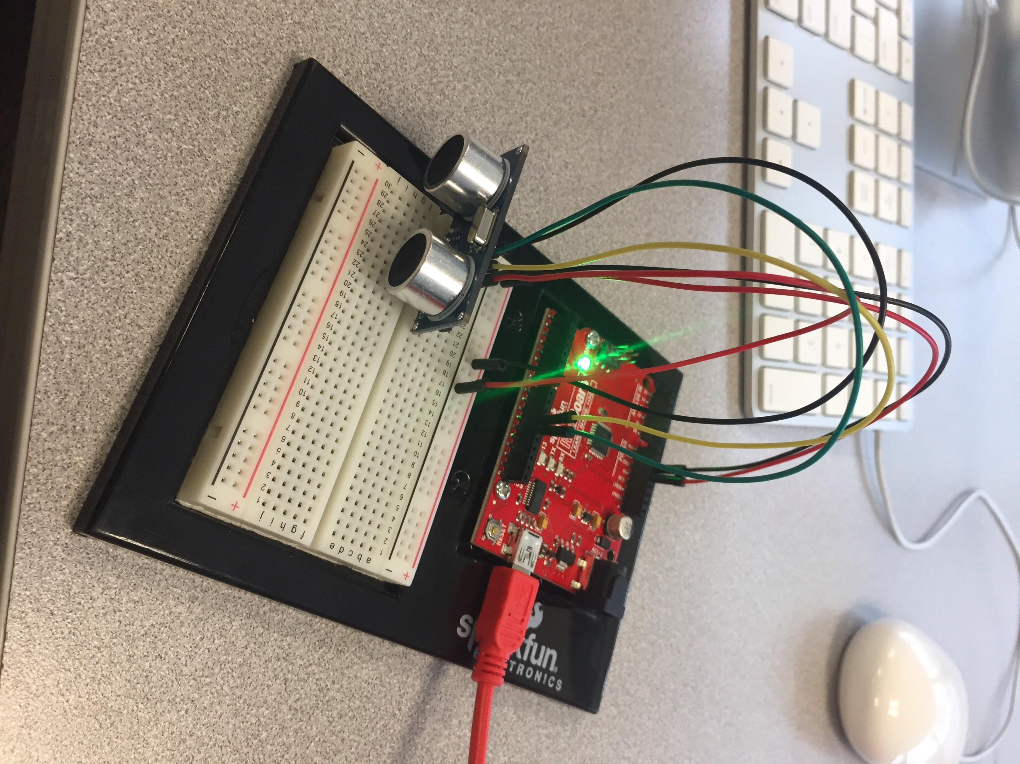
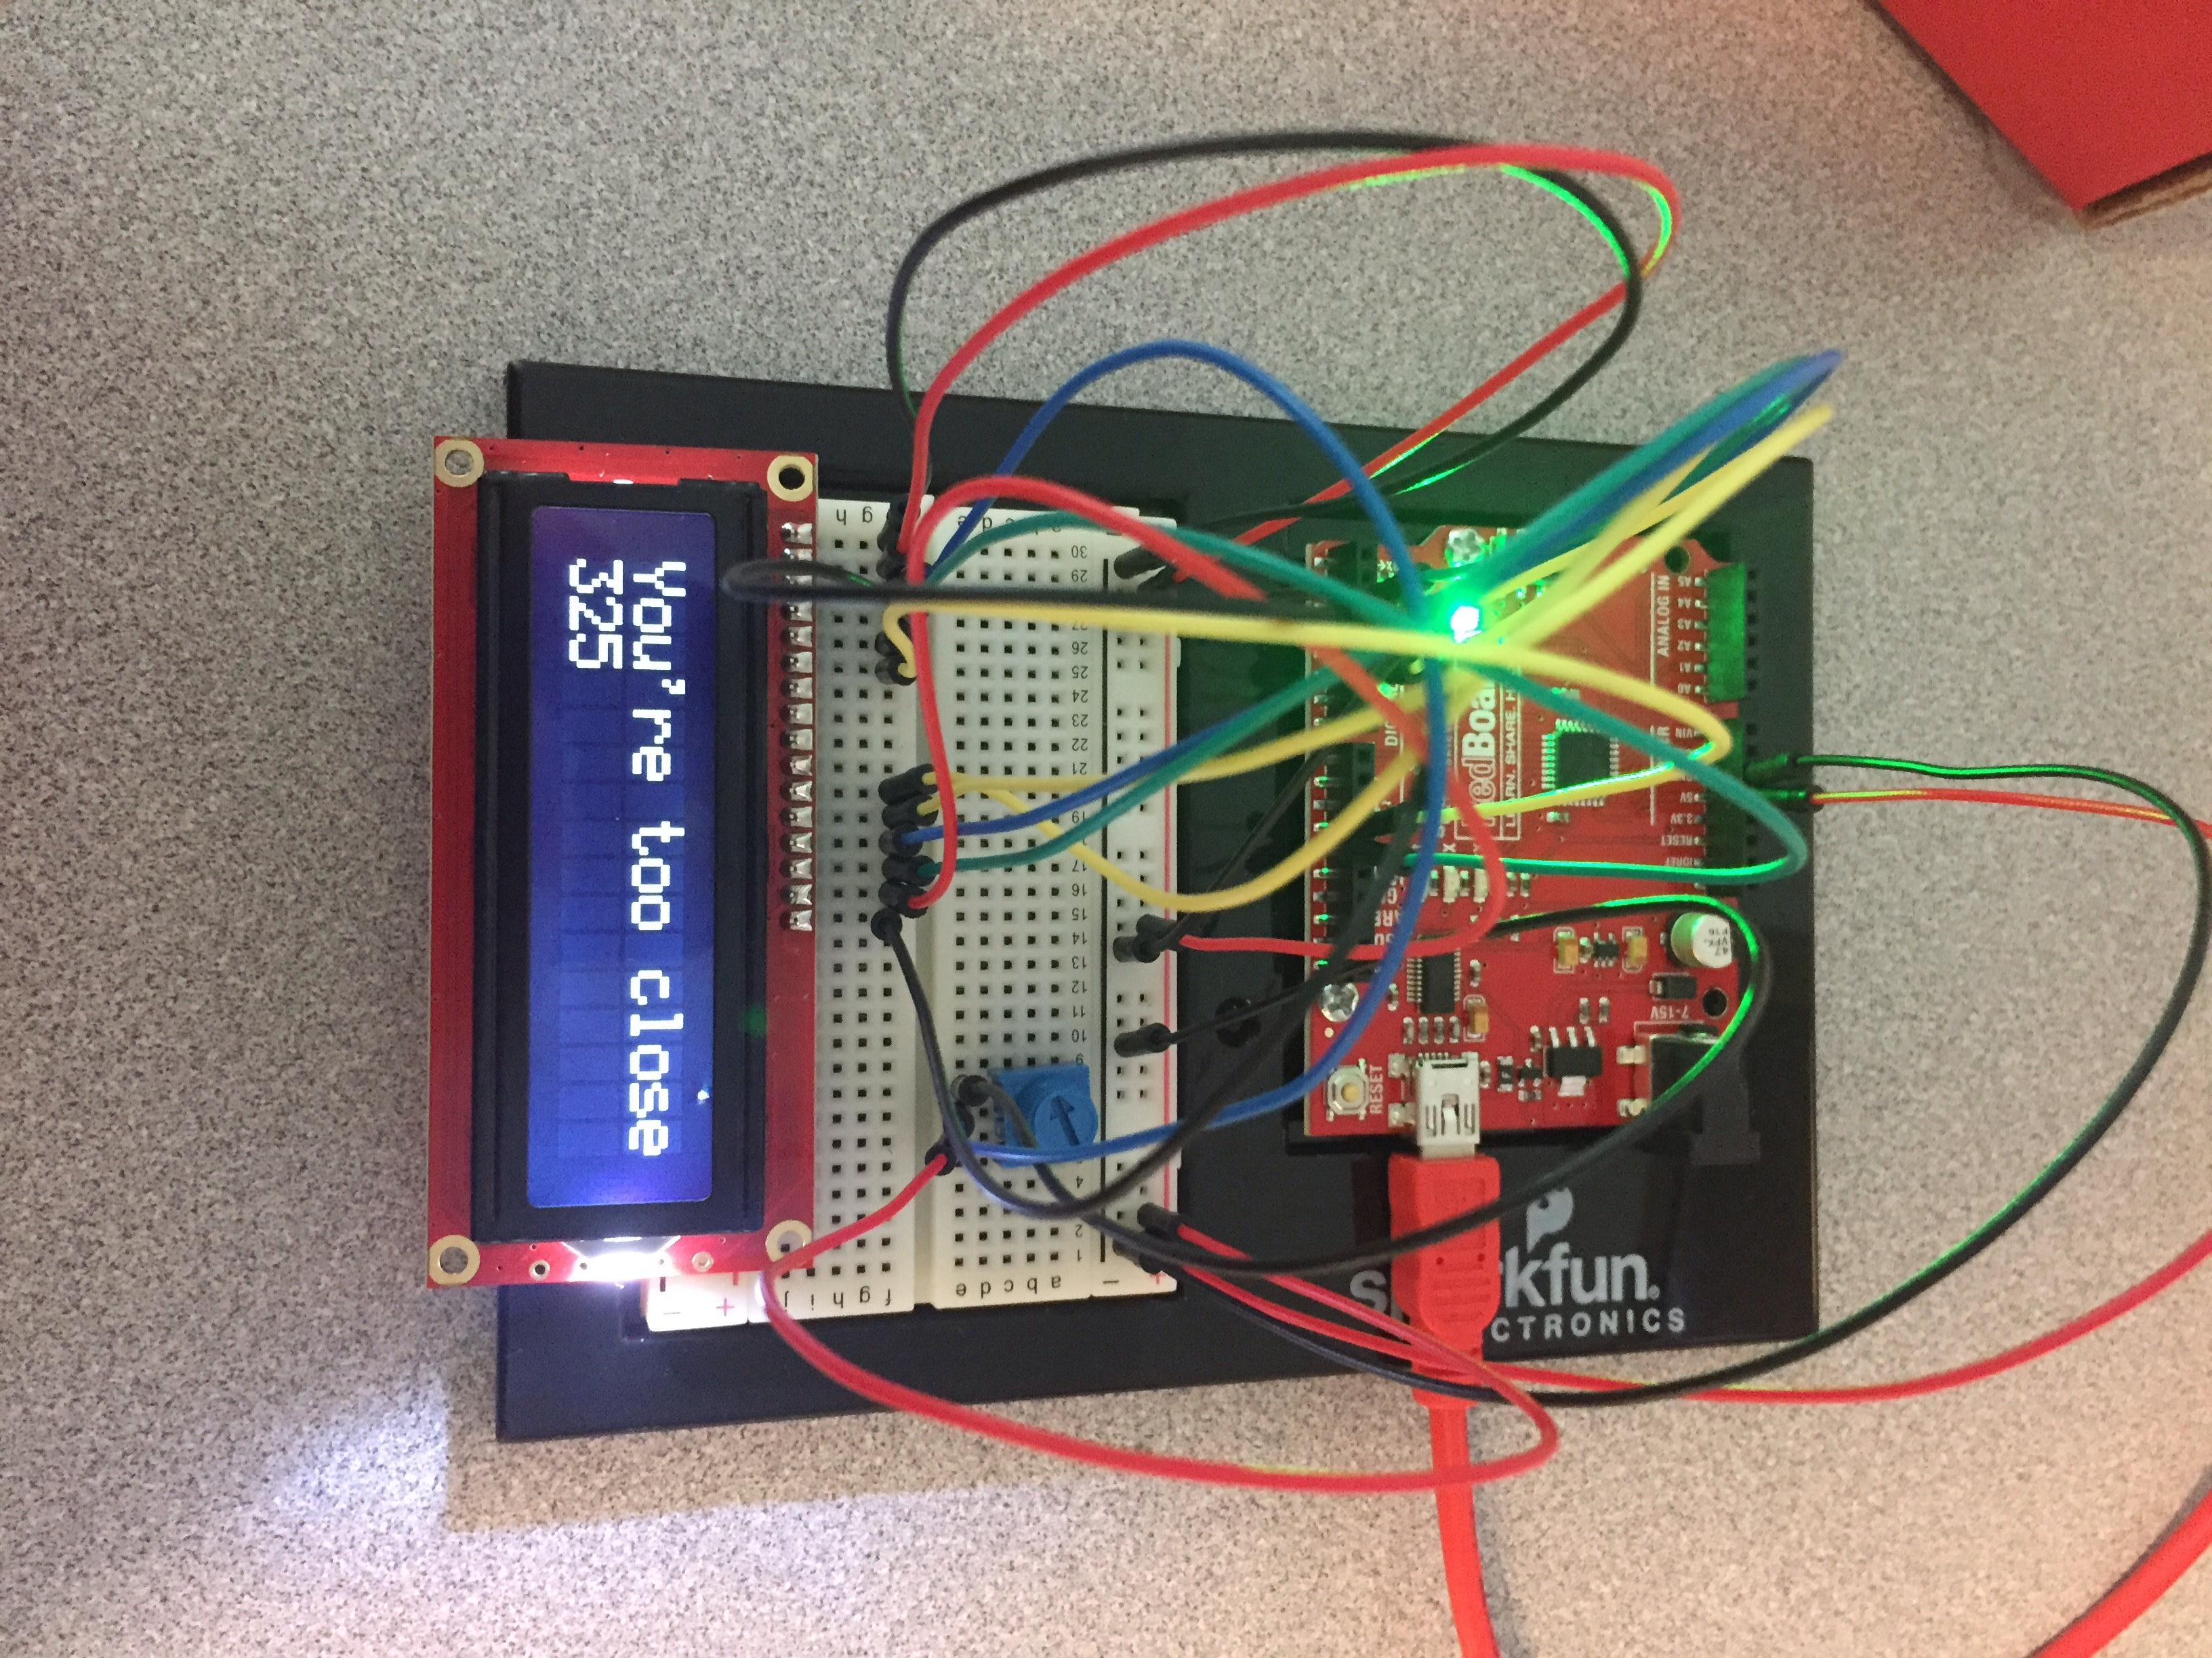
Design Process:

Slide 5
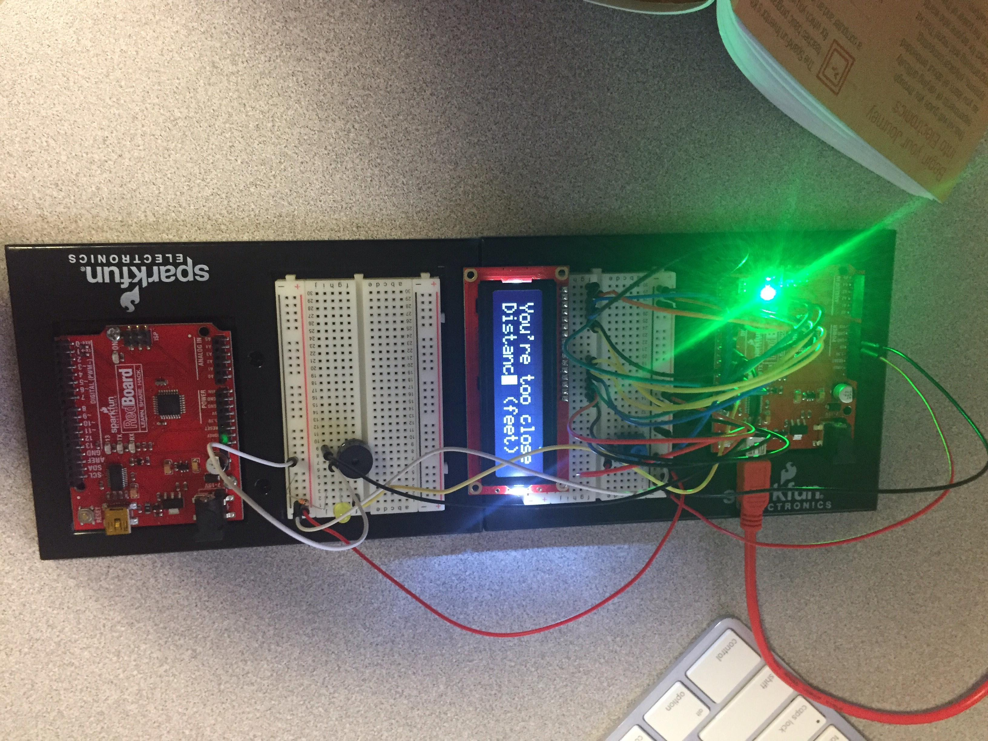
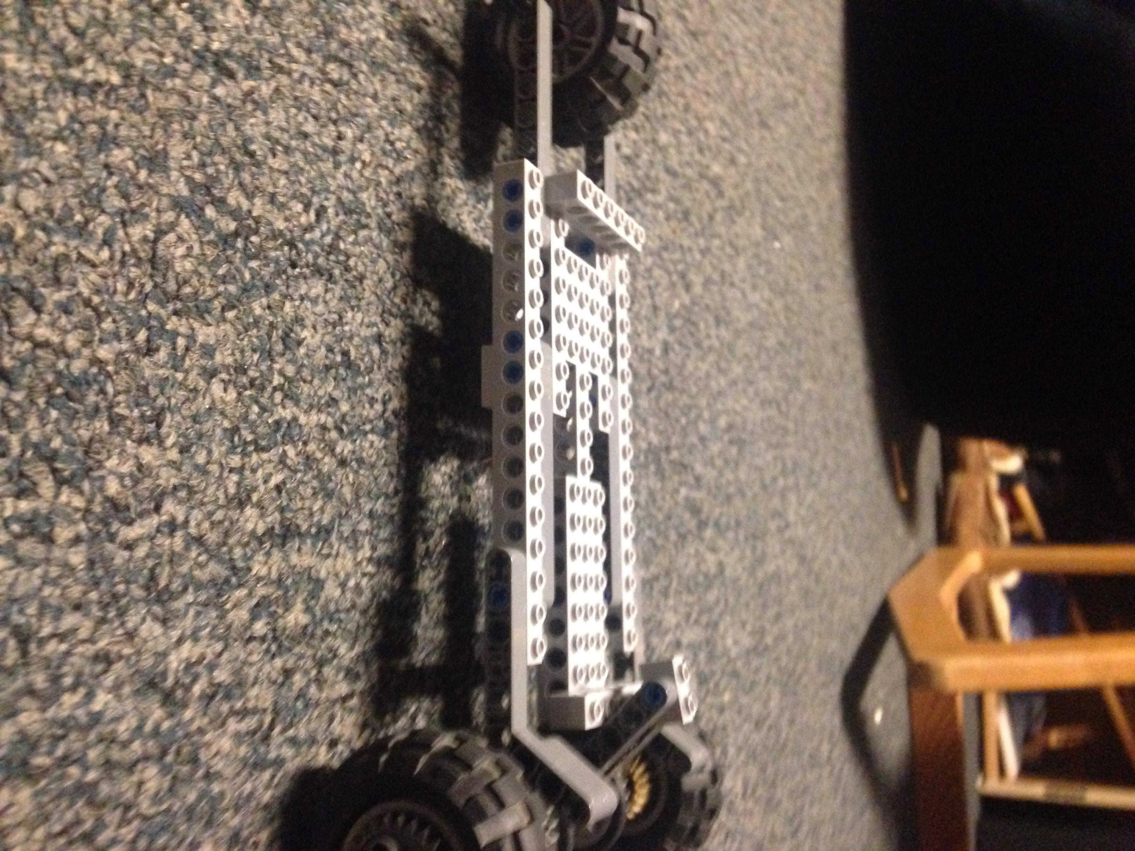
Design Process Continued:

Slide 6

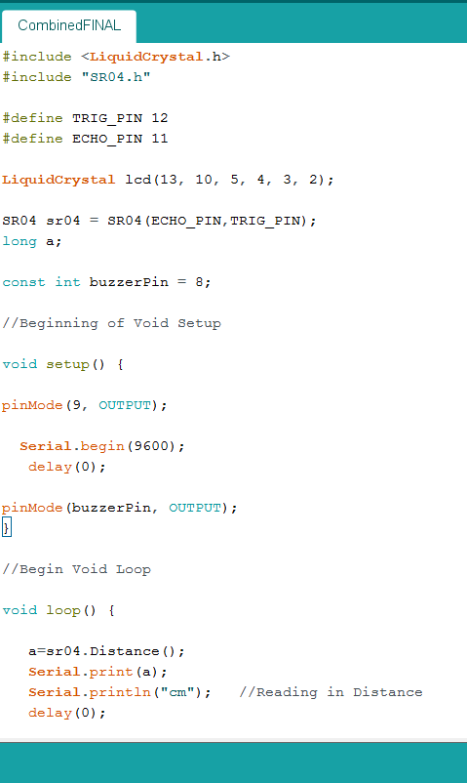
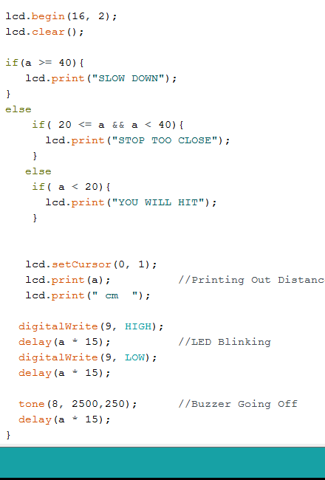
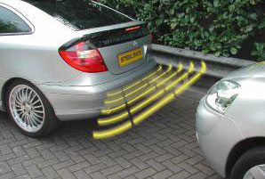
Demonstration:

Slide 7
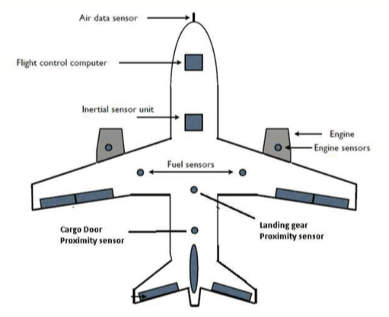
Real World Applications:
All new cars carry the technology of a backup sensor
Planes and helicopters use a similar technology that will tell how far from the ground they are or other objects in the air.
Some sensors can even detect the dimensions of a object at a certain distance

Slide 8
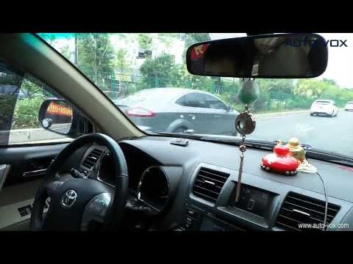
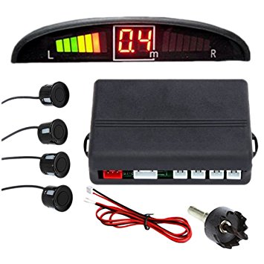
Real Backup Sensor:

Slide 9
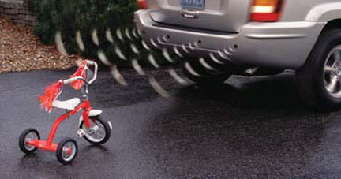
The End
Thank You for watching!

